Slide 1
Photomicrographs of Plant foods
Onions: Green, Red, White, Yellow
Permission to reproduce original photomicrographs used to make this collection may be obtained from
Dr. David O. Norris at
david.norris@colorado.edu

Slide 2
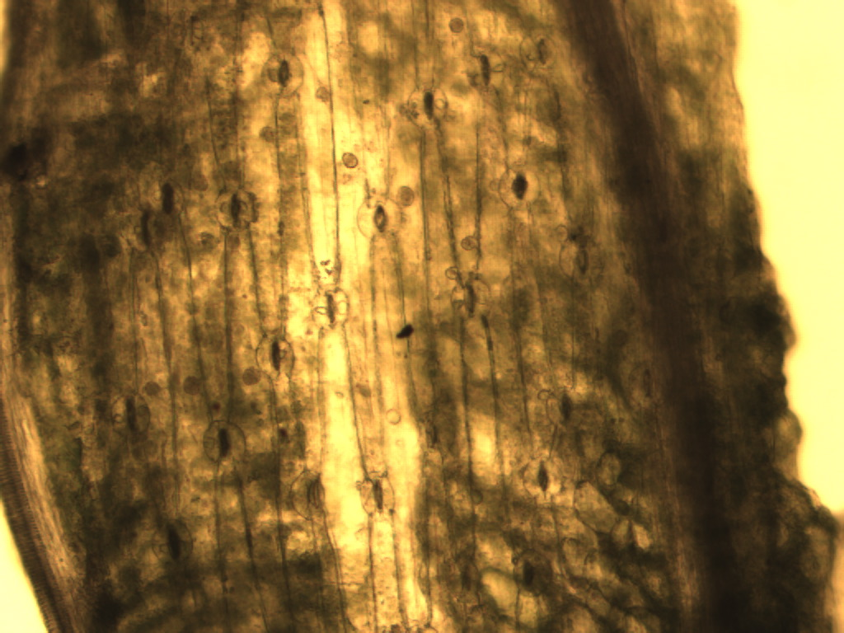
Notes:
316. Allium cepa L. Onion, green; Elongate epidermal cells, stomata (arrows) separating elongate cells longitundinally, 10X. Compare to leek and chives.

Slide 3
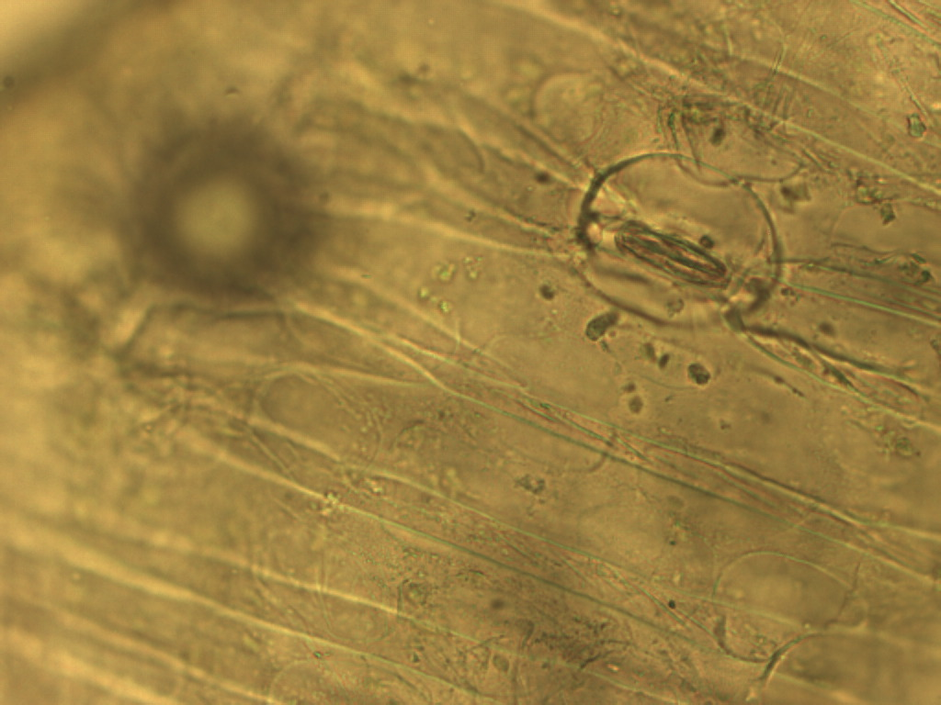
Notes:
317. Onion, green. Epidermal cells and stomate (arrow), 40X

Slide 4
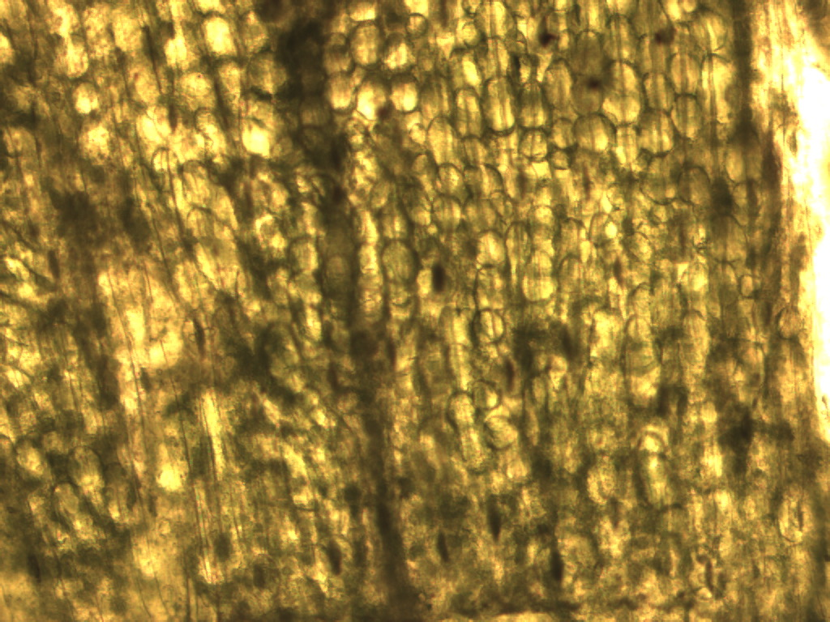
Notes:
318. Onion, green; spherical parenchymal cells and elongate epithelial cells, 10X.

Slide 5
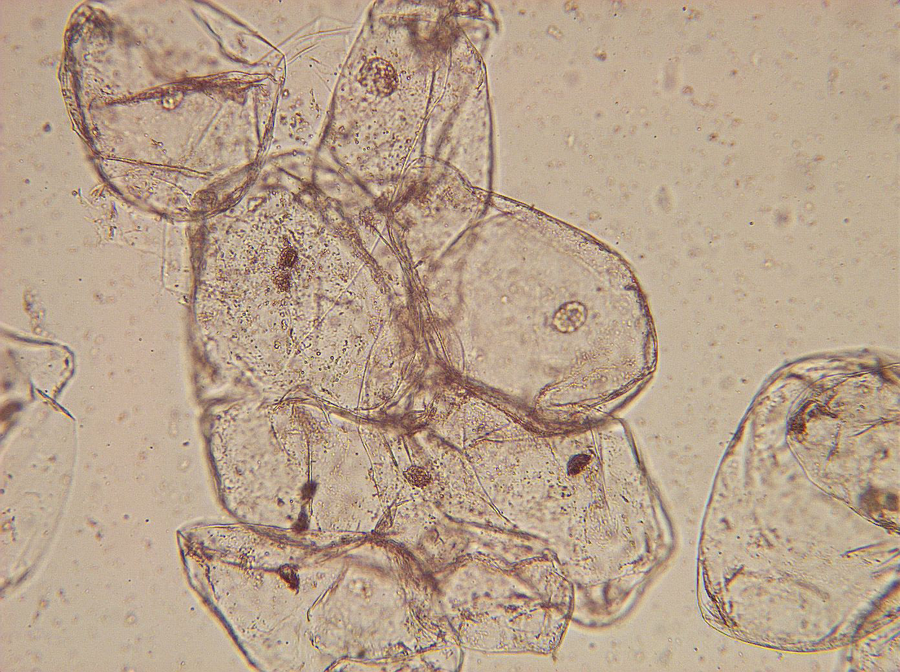
Notes:
319. Allium cepa L. Onion, red; isolated pulp parenchymal cells, 10X

Slide 6
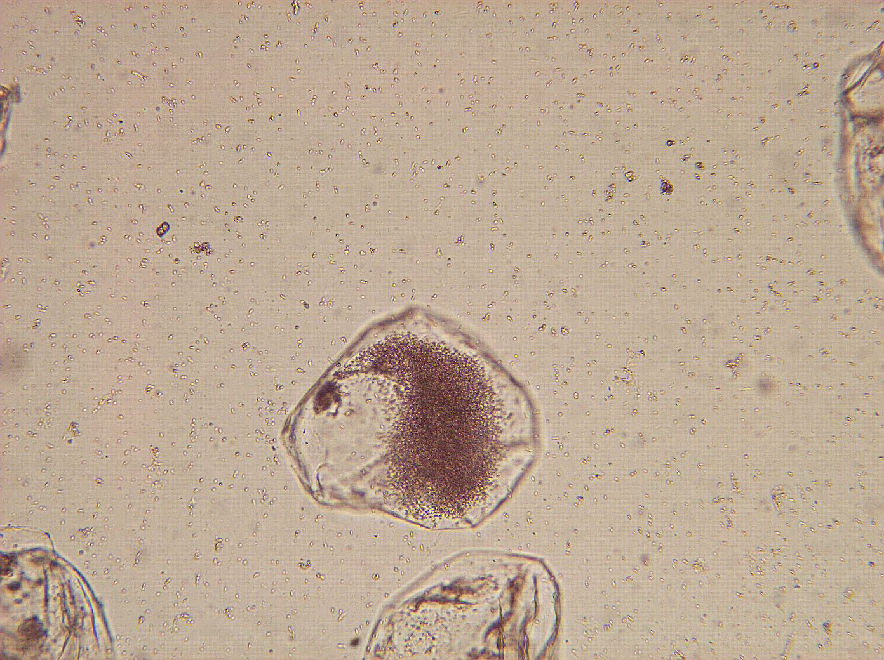
Notes:
320. Onion, red; isolated parenchymal cell containing red pigment, anthocyanin, 25X.

Slide 7
Notes:
321. Allium cepa L. Onion, white/yellow; Elongate epidermal cells stained with safranin, 10X

Slide 8
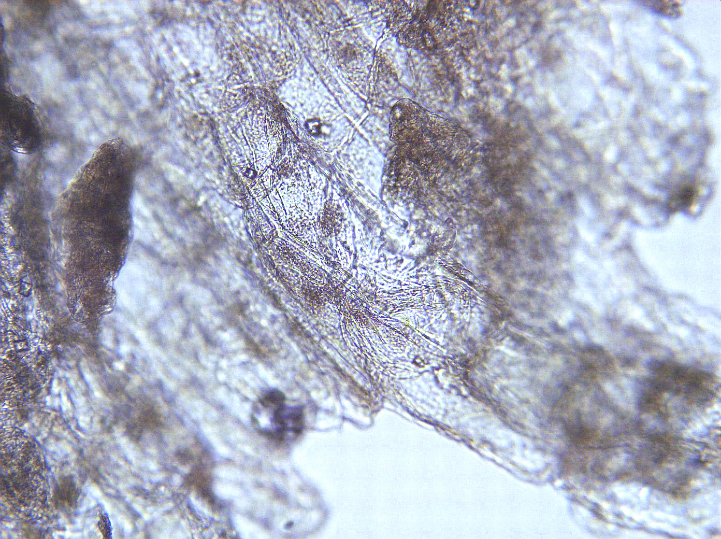
Notes:
322. Onion, white/yellow. Pulp parenchymal cells, 10X.

Slide 9
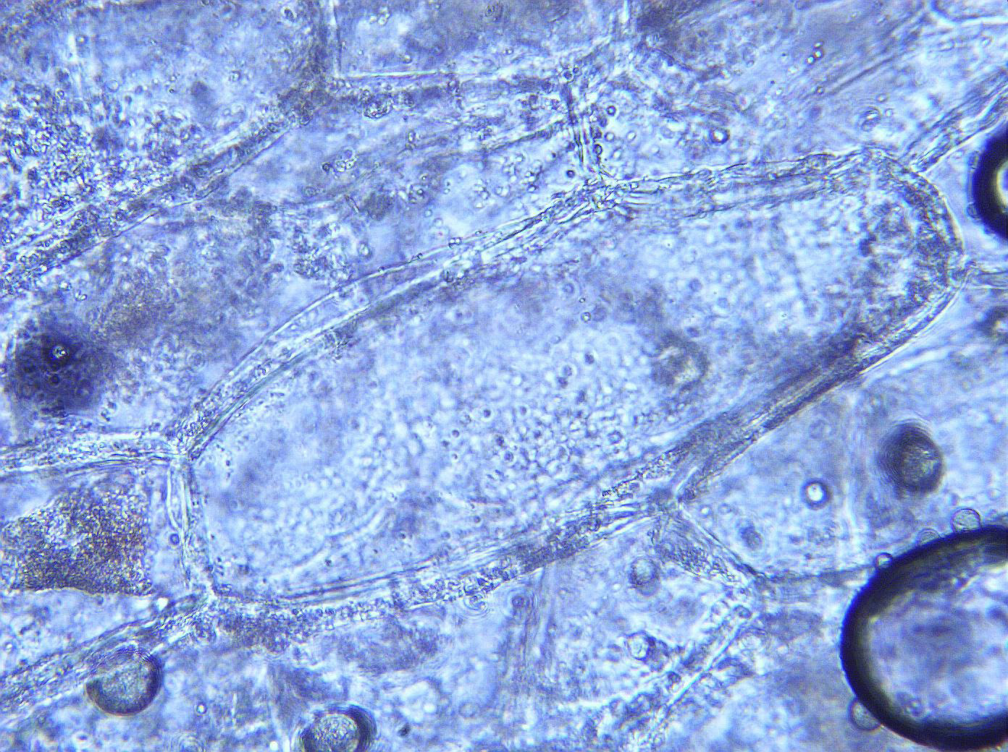
Notes:
323. Onion, white/yellow. Parenchymal cells, 25X.

Slide 10
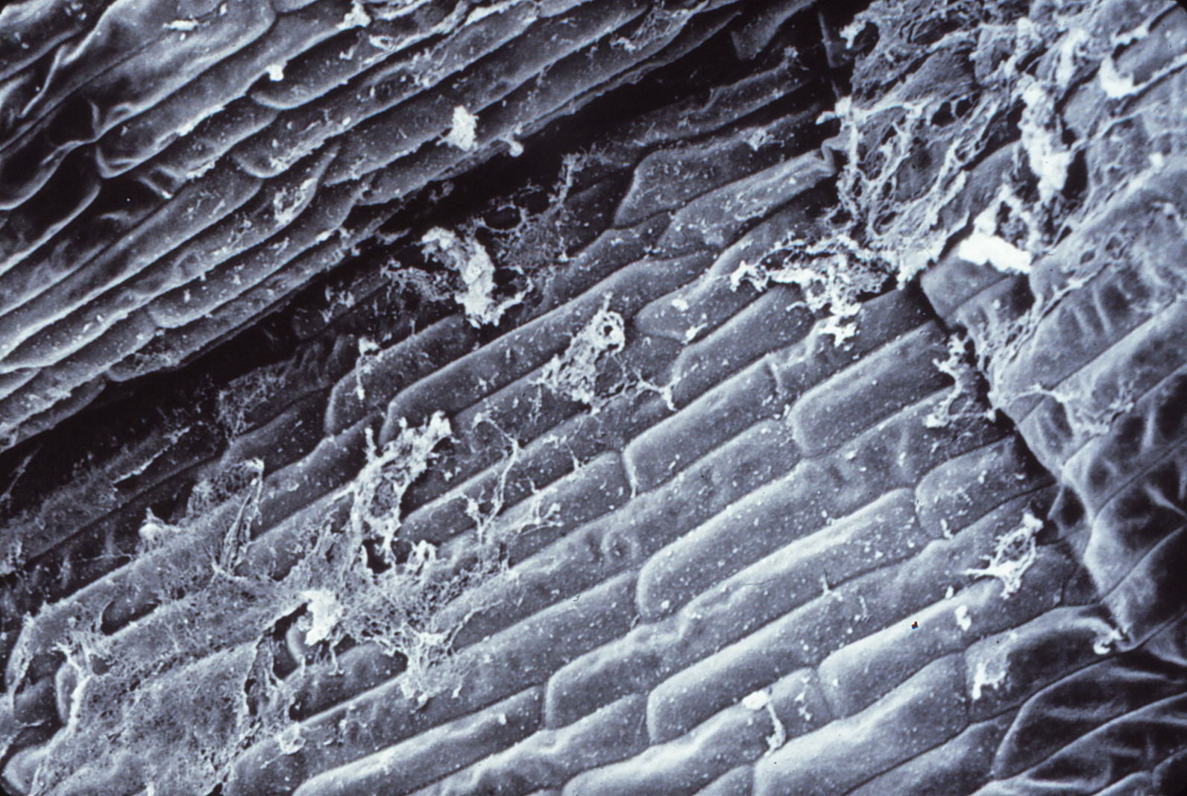
100 µm
Notes:
324. Onion, white/yellow. SEM of parenchymal cells. Courtesy of Dr, Meredith A. Lane.

